Slide 1
Welcome!
Sunday
Worship 9:30 AM
Sunday
Bible Class (Livestream) 5:00 PM
Wednesday
Bible Class (Livestream) 7:00 PM
www.SunsetchurchofChrist.net

Slide 2
Order of Service
Opening Prayer | Gregor Hinckley
Song - 6(s) | Grant Haines
Song - 160 | Grant Haines
Lord’s Supper | Anthony Ward
Song - 219 | Grant Haines
Lesson | Brian Haines
Song - 320 | Grant Haines
Closing | Michael Hetzer

Slide 3
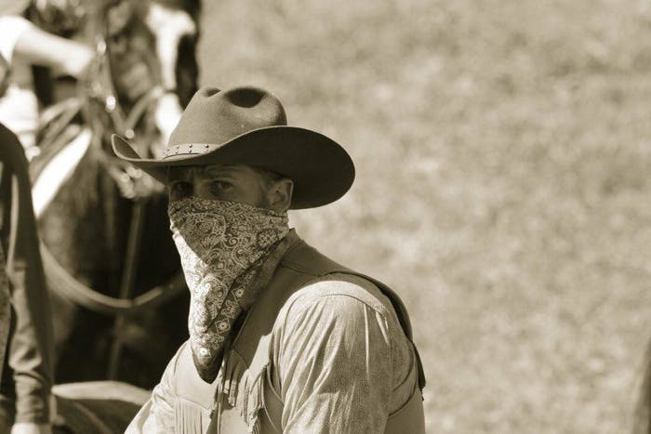
Notes:
Wearing masks – most of us really hate wearing masks. We do so for the sake of others.
Remember when wearing a mask was all about hiding your identity? Like a train robber?

Slide 4
James 5:16
Confess your trespasses to one another, and pray for one another, that you may be healed. The effective, fervent prayer of a righteous man avails much.
Notes:
We are commanded to confess our sins to one another. This is perhaps one of the hardest

Slide 5
James 5:16
Confess your trespasses to one another, and pray for one another, that you may be healed. The effective, fervent prayer of a righteous man avails much.
Notes:
We are commanded to confess our sins to one another. This is perhaps one of the hardest

Slide 6
Confessing Our Sins
Why are we to do this?
Why is it so difficult?
What should this look like?

Slide 7
Why Confession
NOT:
As a way to be forgiven of sin
1 John 1:9
For a power of the church
John 20:23 w/ Luke 24:47
Notes:
1Jo 1:9 If we confess our sins, He is faithful and just to forgive us our sins and to cleanse us from all unrighteousness.
Joh 20:23 "If you forgive the sins of any, they are forgiven them; if you retain the sins of any, they are retained.“
Lu 24:47 "and that repentance and remission of sins should be preached in His name to all nations, beginning at Jerusalem.

Slide 8
Why Confession
We confess:
Seeking to be helped by others
Galatians 6:1-2
Seeking to be accountable for sin
Hebrews 12:14-15
Seeking to encourage others
2 Corinthians 12:7-10
Notes:
Ga 6:1 ¶ Brethren, if a man is overtaken in any trespass, you who are spiritual restore such a one in a spirit of gentleness, considering yourself lest you also be tempted. 2 Bear one another's burdens, and so fulfill the law of Christ.
Heb 12:14 Pursue peace with all people, and holiness, without which no one will see the Lord: 15 looking carefully lest anyone fall short of the grace of God; lest any root of bitterness springing up cause trouble, and by this many become defiled;
2Co 12:7 And lest I should be exalted above measure by the abundance of the revelations, a thorn in the flesh was given to me, a messenger of Satan to buffet me, lest I be exalted above measure. 8 Concerning this thing I pleaded with the Lord three times that it might depart from me. 9 And He said to me, "My grace is sufficient for you, for My strength is made perfect in weakness." Therefore most gladly I will rather boast in my infirmities, that the power of Christ may rest upon me. 10 Therefore I take pleasure in infirmities, in reproaches, in needs, in persecutions, in distresses, for Christ's sake. For when I am weak, then I am strong.

Slide 9
Why Is Confession Hard
A lack of trust between brethren
Galatians 5:15
A prideful heart
I John 1:8-10
Proverb 20:9
Notes:
Ga 5:15 But if you bite and devour one another, beware lest you be consumed by one another!
1Jo 1:8 ¶ If we say that we have no sin, we deceive ourselves, and the truth is not in us. 9 If we confess our sins, He is faithful and just to forgive us our sins and to cleanse us from all unrighteousness. 10 If we say that we have not sinned, we make Him a liar, and His word is not in us.
Pr 20:9 ¶ Who can say, "I have made my heart clean, I am pure from my sin"?

Slide 10
Seeing Confession
Trusted brethren
Desire to overcome weakness
Absence of judgment
Lifting one another up in confession
Notes:
What does confession look like?

Slide 11
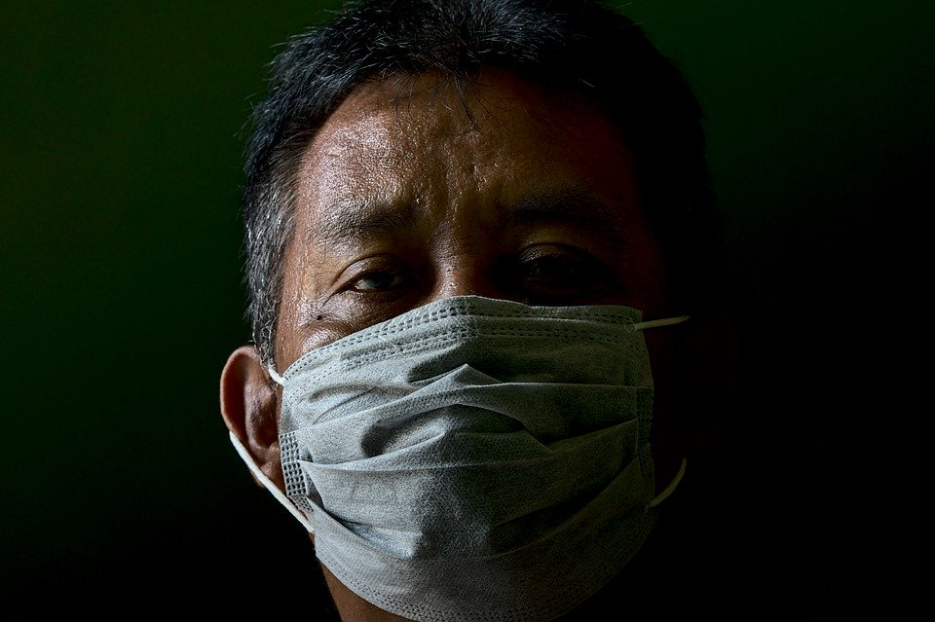
Masking Confession
Spiritually: Don’t wear a mask!
Hard to breath
Hides my expression
Uncomfortable
Openly admit your sins

Slide 13
Confession and Repentance
Confession means admitting to sin
Repentance means admitting and changing

Slide 14
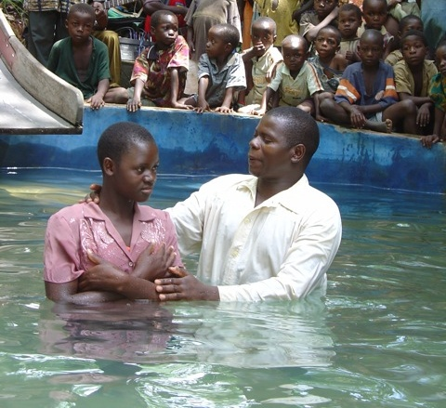
Confession and Repentance
Then Peter said to them, "Repent, and let every one of you be baptized in the name of Jesus Christ for the remission of sins; and you shall receive the gift of the Holy Spirit” Acts 2:38

